Slide 1
Kinview

Slide 2
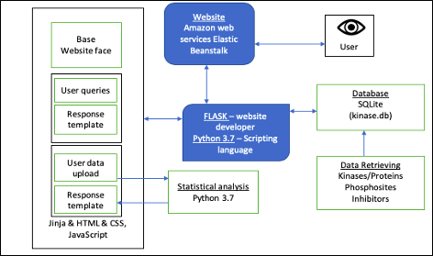
Software architecture

Slide 3
Datamining
We needed information on:
Kinases
Substrates
Phosphosites
Inhibitors

Slide 4
Our sources
Uniprot
PhosphositePlus
Ensembl
European Bioinformatics Institute Protein Database

Slide 5
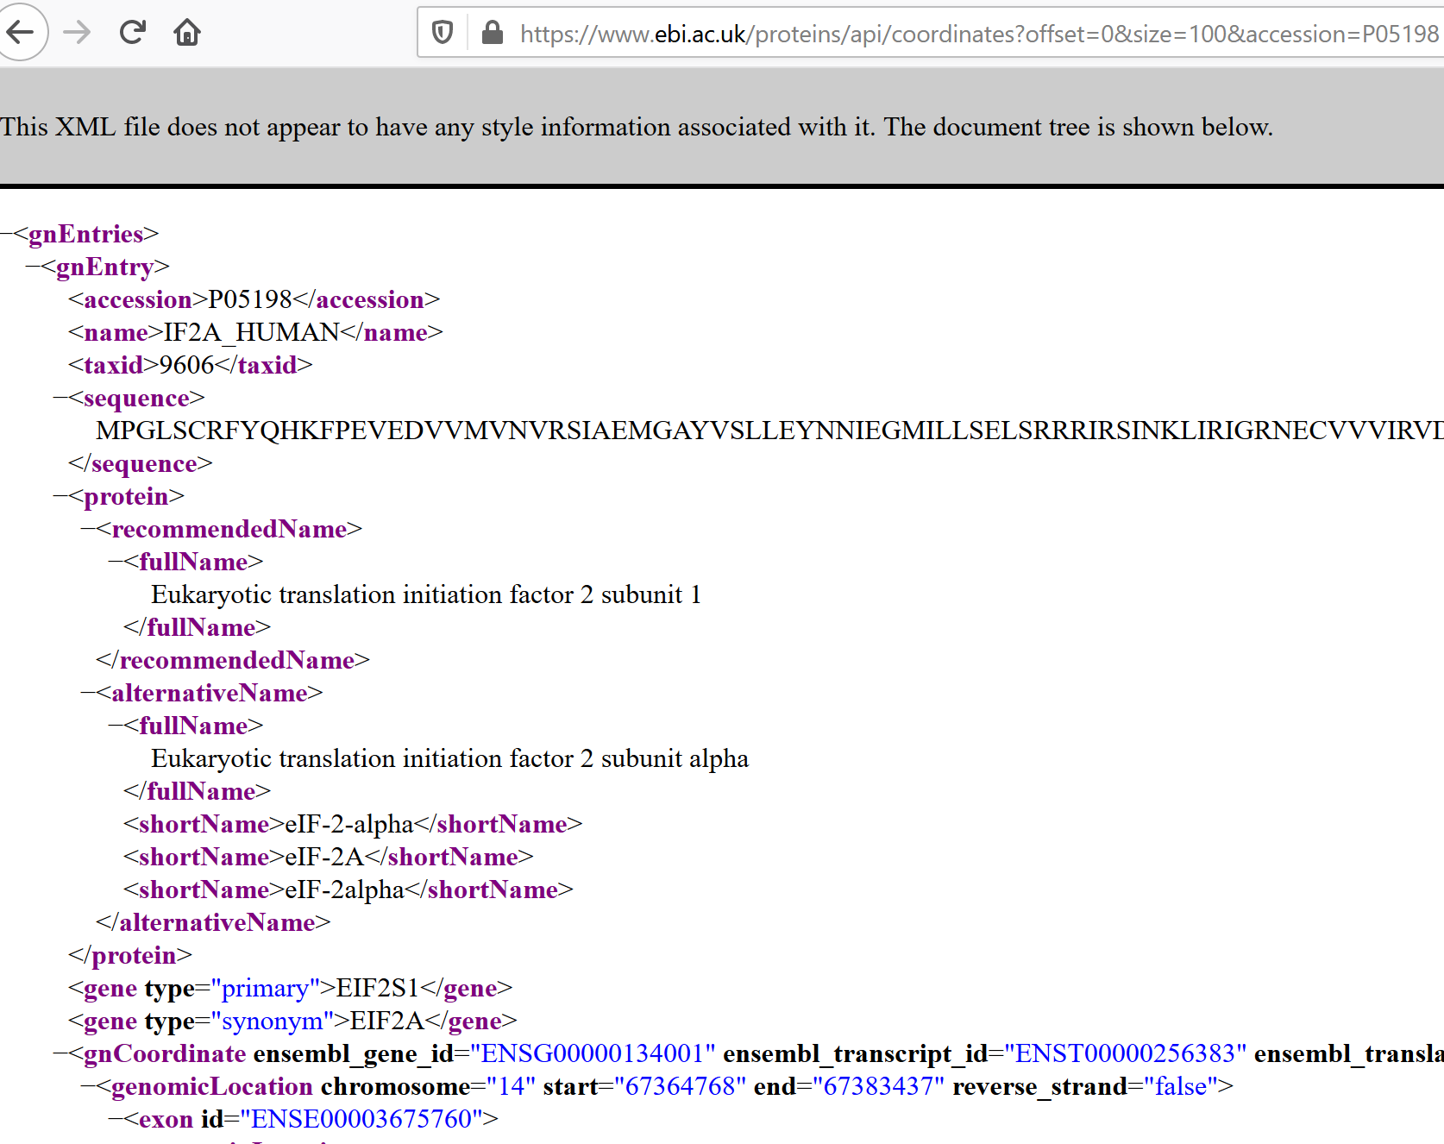

Slide 6
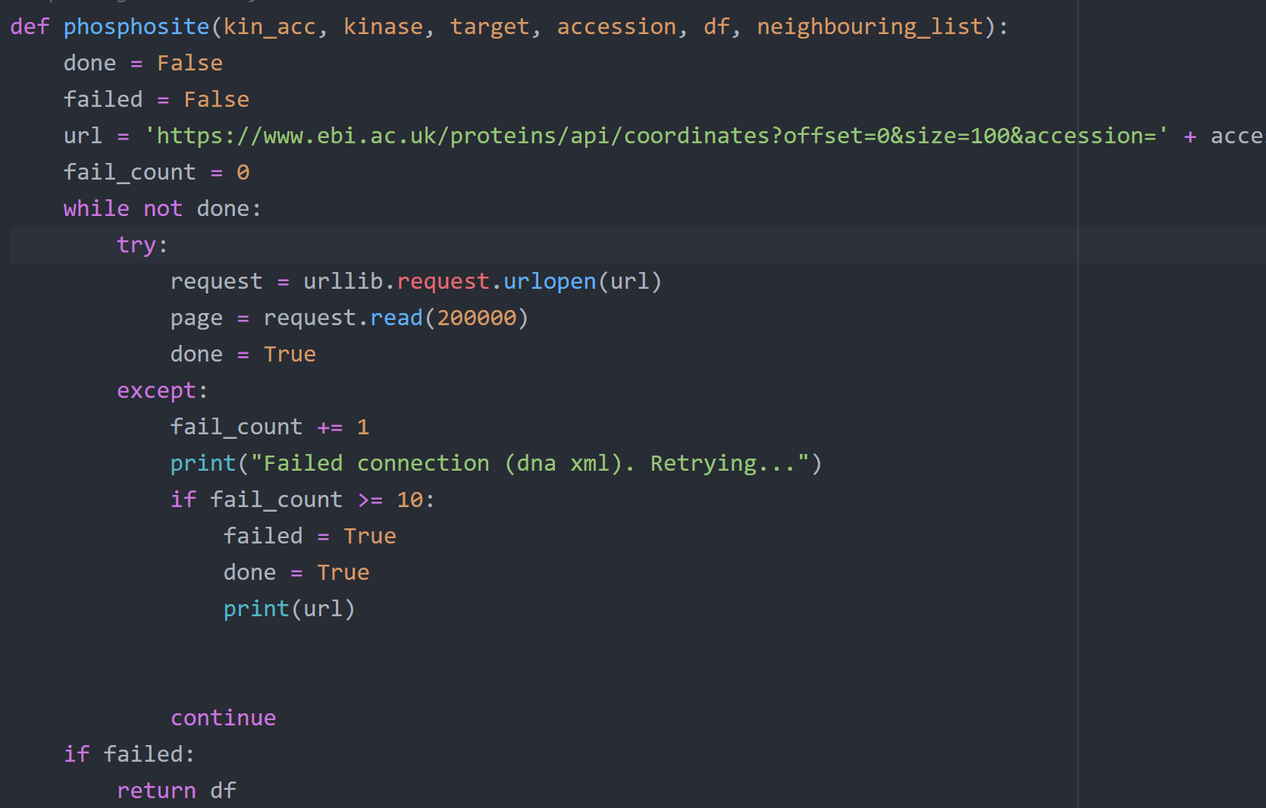

Slide 7
Inhibitor Datamining
1 basic information
“International Centre for Kinase Profiling” (http://www.kinase-screen.mrc.ac.uk/)
2 Aliases
ChemSpider API https://developer.rsc.org/
ChemSpipyhttps://chemspipy.readthedocs.io/en/latest/guide/compound.html
3 picture
open babel http://openbabel.org/wiki/Main_Page

Slide 8
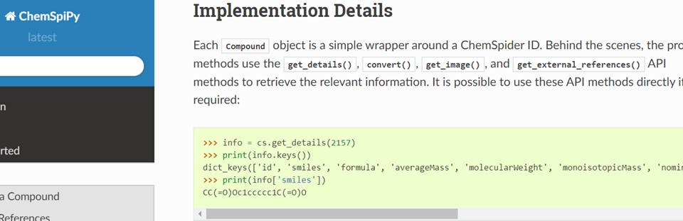
ChemSpider API https://developer.rsc.org/
ChemSpipyhttps://chemspipy.readthedocs.io/en/latest/guide/compound.html

Slide 9
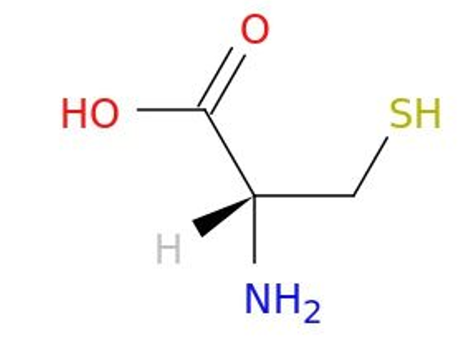
open babel http://openbabel.org/wiki/Main_Page
example:
obabel -:"C([C@@H](C(=O)O)N)S" -opng -O cys.png
SMILES --->

Slide 10
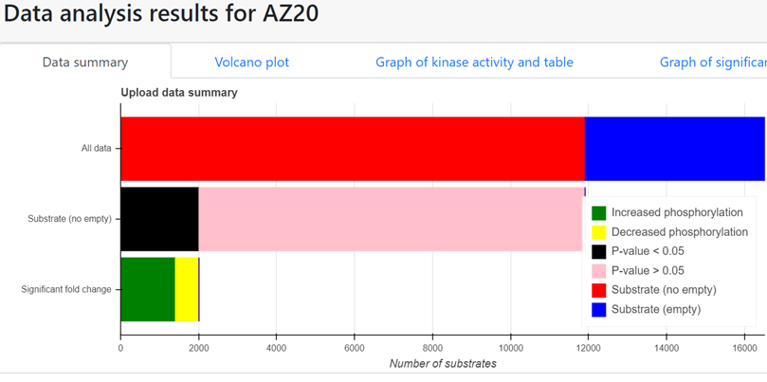

Slide 11
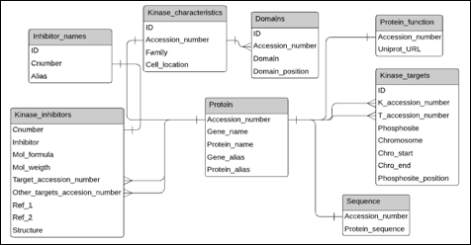
Database schema

Slide 12
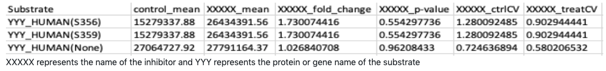

Phosphoproteomic data analysis
Casado Pet al. (2013)
Notes:
s, denotes the mean log2(FC) of known phosphosite substrates of the given kinase, p represents the mean log2(FC) of all phosphosites in the dataset, m denotes the total number of phosphosite substrates identified from the experiment that annotate to the specified kinase, and δ denotes the standard deviation of the log2(FC) across all phosphosites in the dataset.

Slide 13
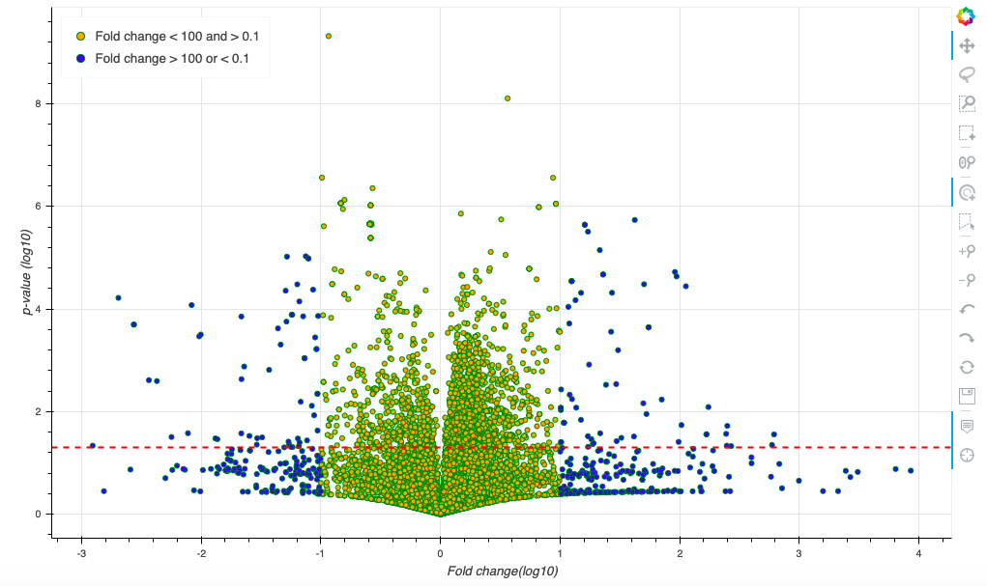
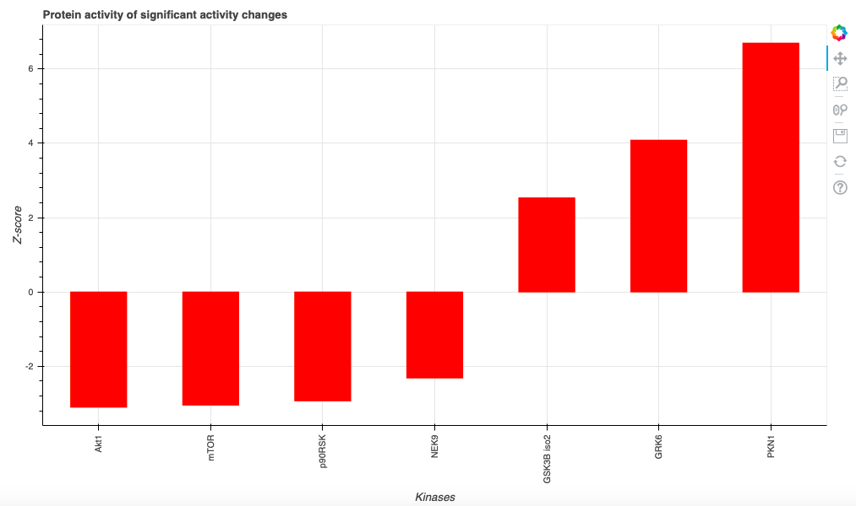
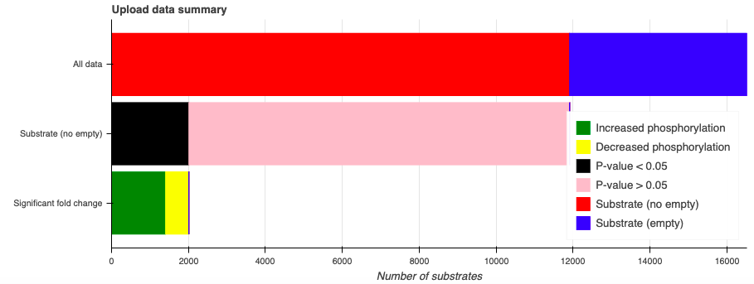
Phosphoproteomic data analysis

Slide 14
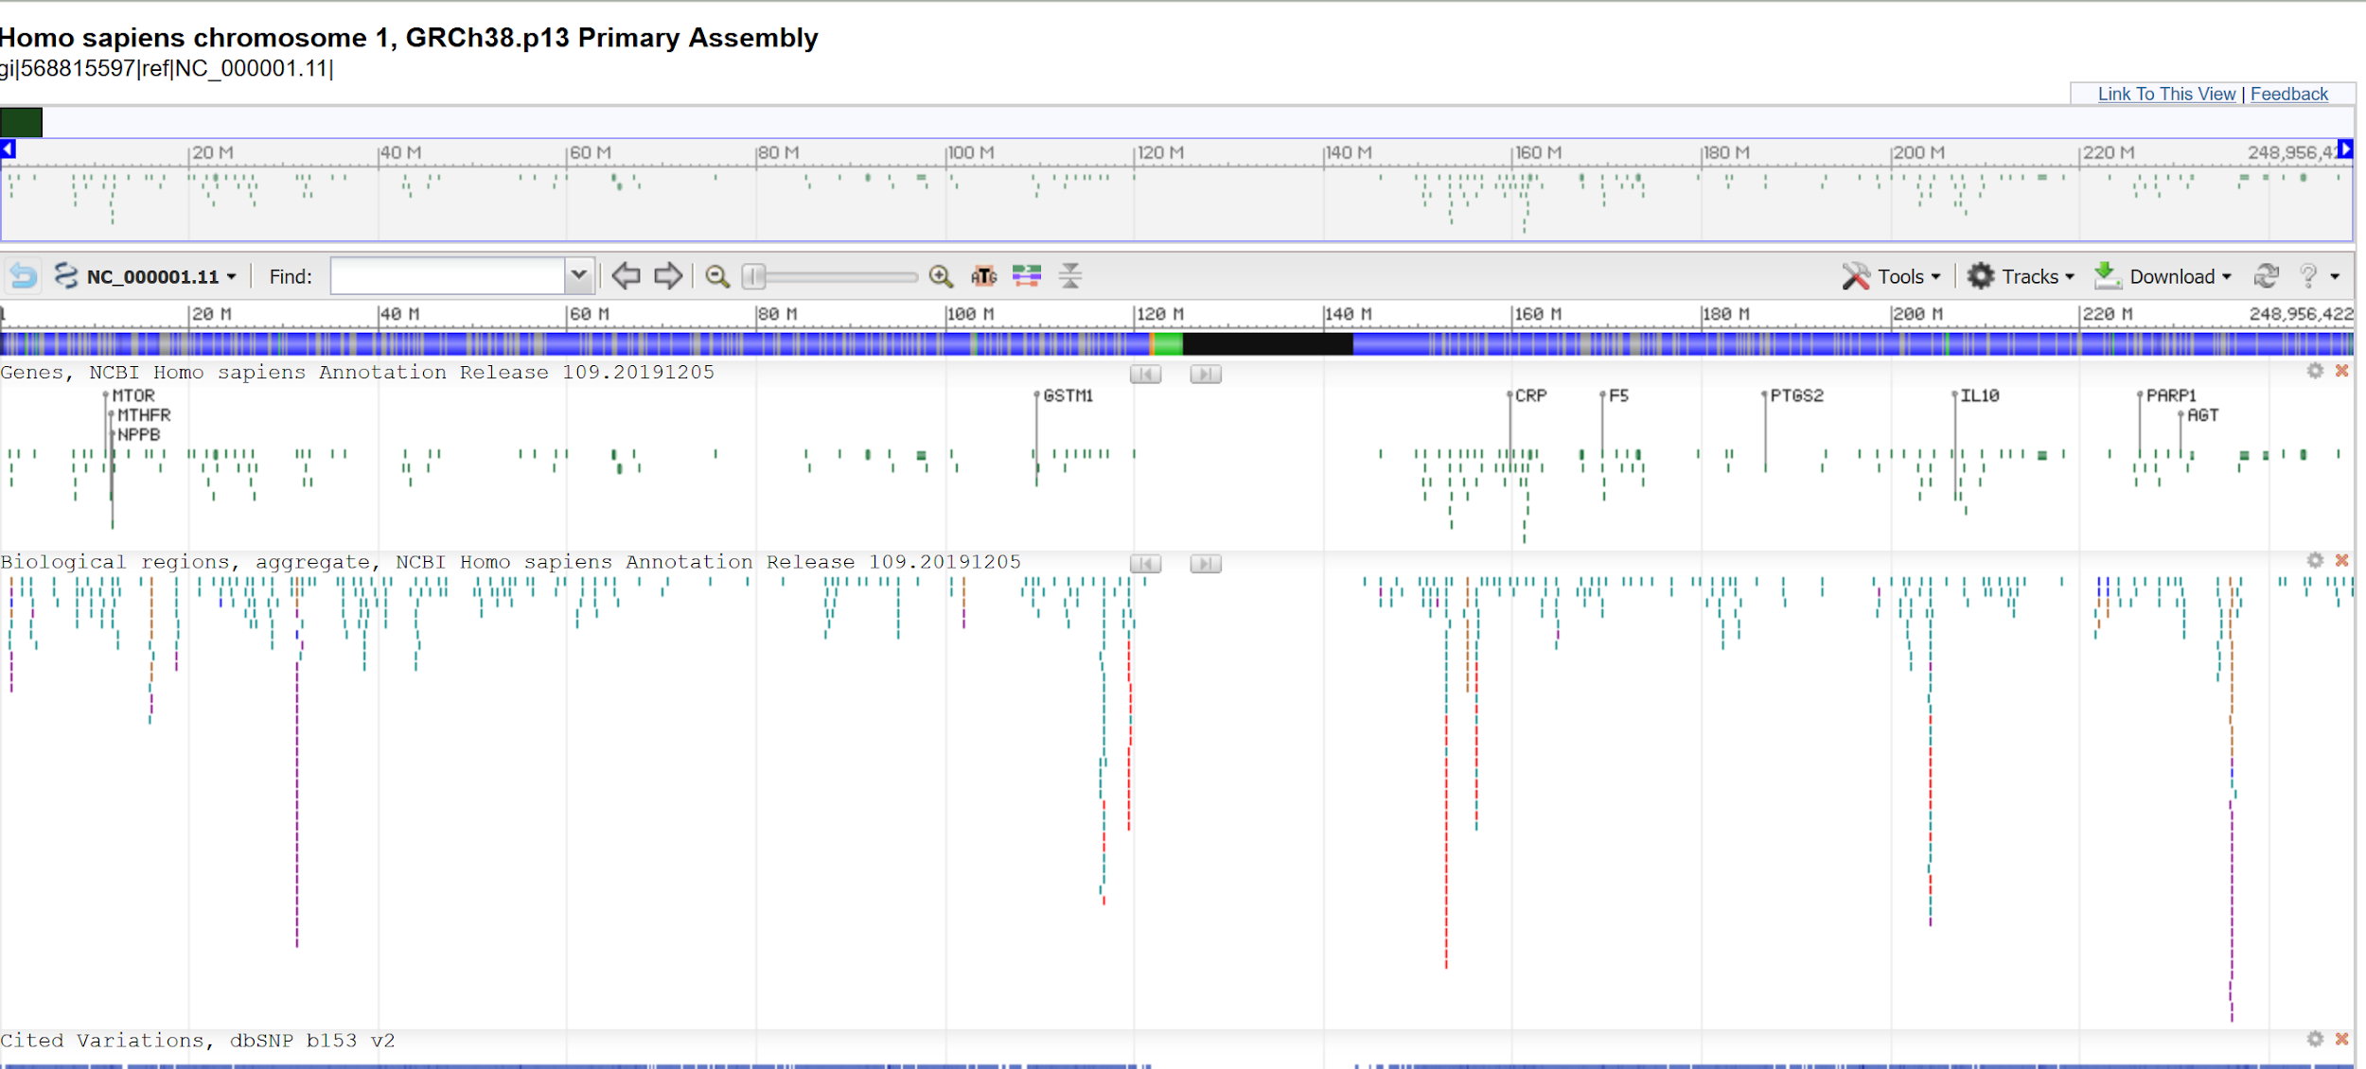
Genome Browser (NCBI Sequence viewer)

Slide 15
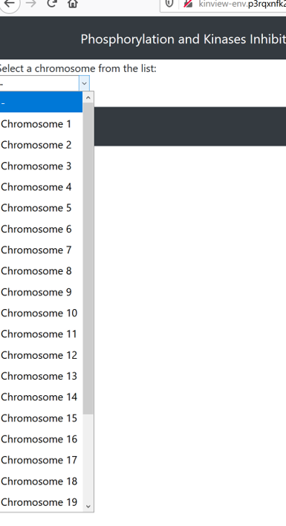

Slide 16
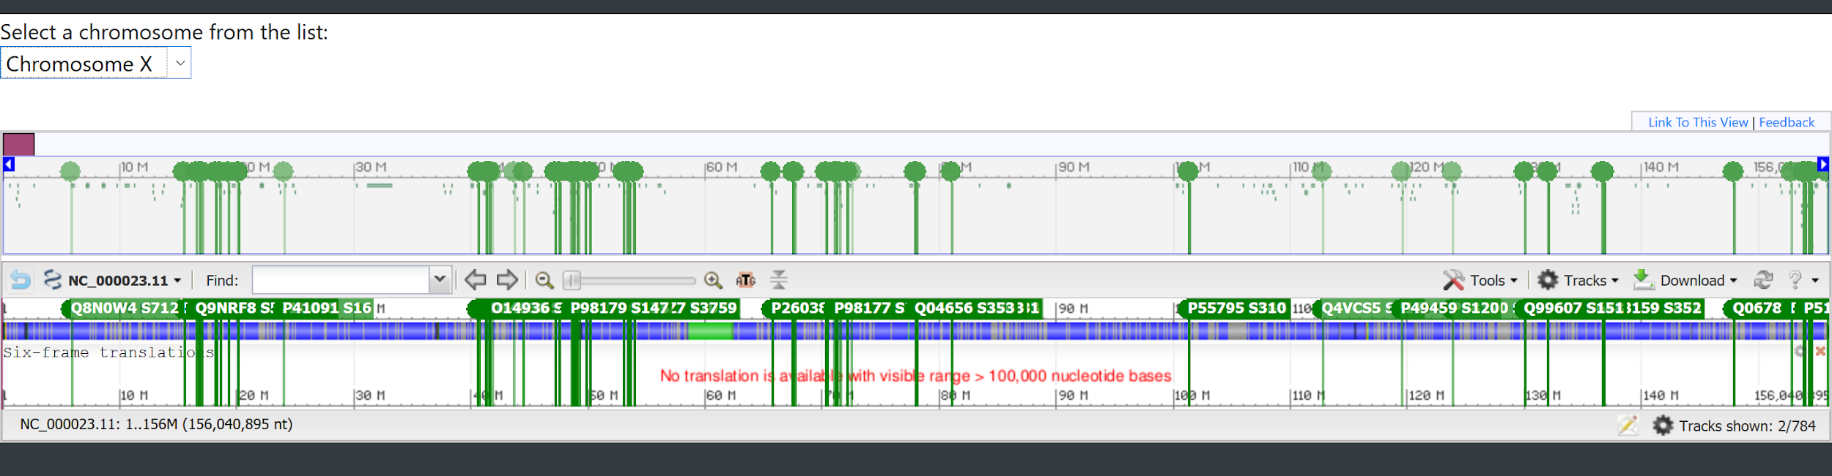

Slide 17

Deployment (Elastic Beanstalk)

Slide 18
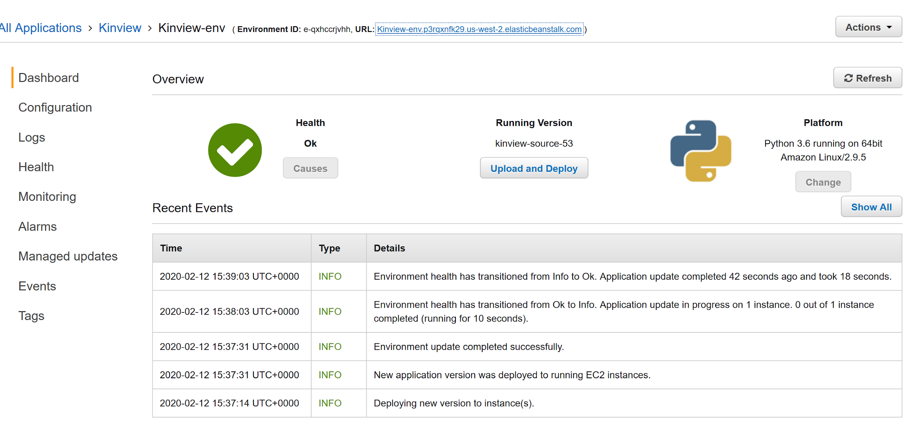
Advantages
Mostly automatic server configuration
Free (At least for 12 months)
Supports Python
Very quick to setup

Slide 19
Disadvantages
Time to deploy is comparatively quite long
Fails to deploy at times with very little in the way of giving reasons for the failure

Slide 20
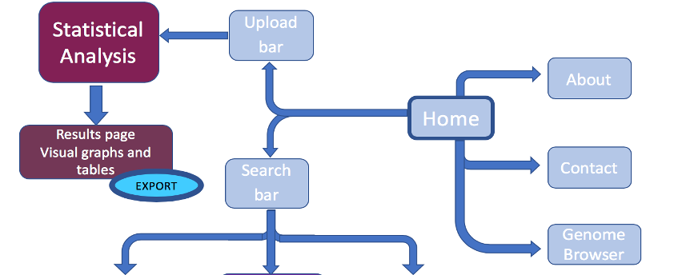
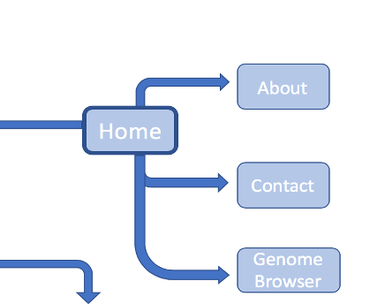
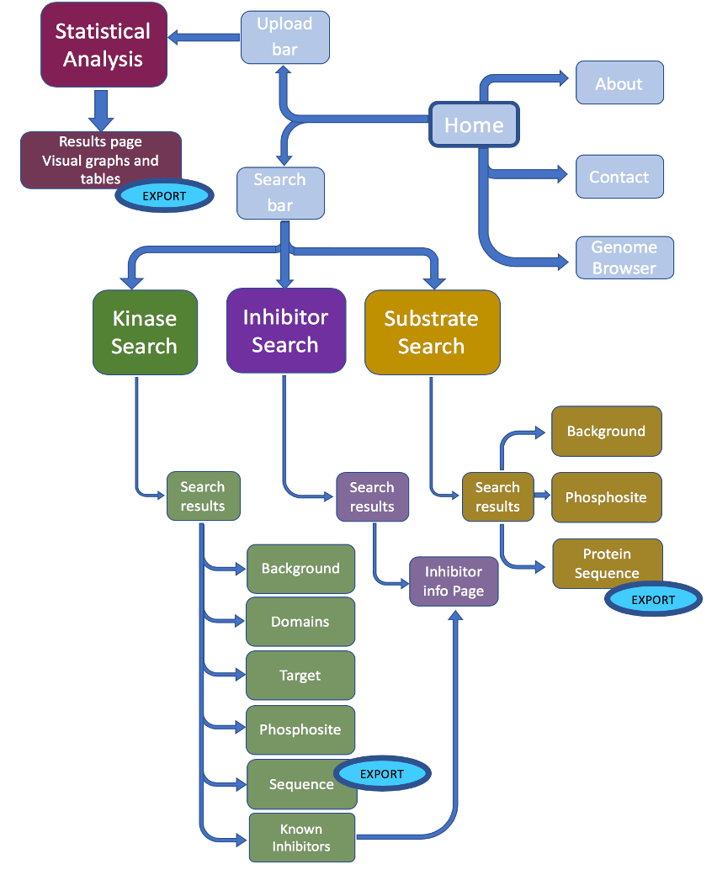
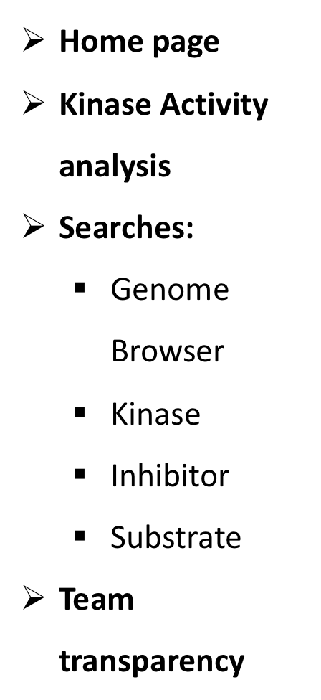
Website architecture

Slide 21
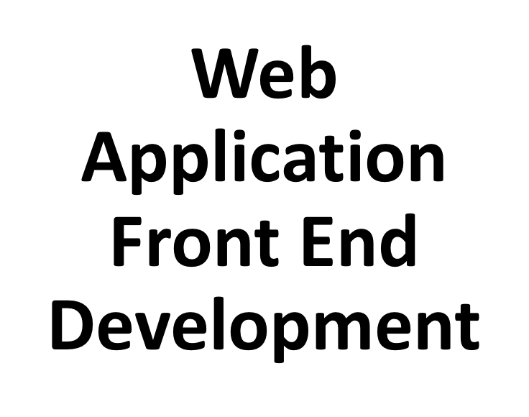

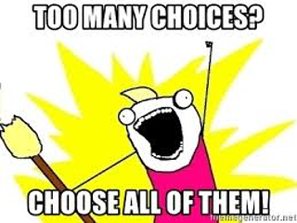

Slide 22


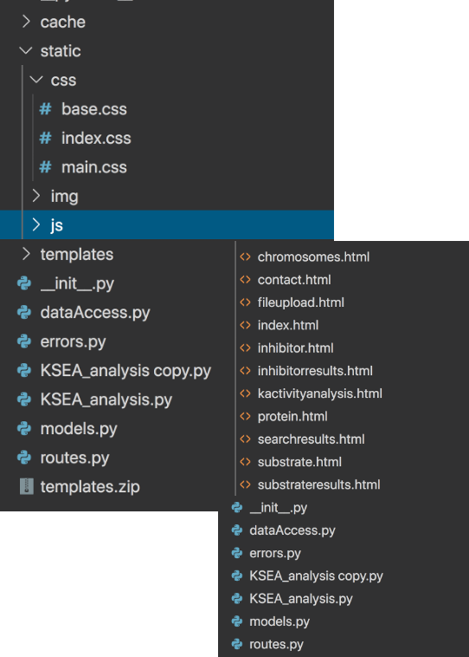



Slide 23

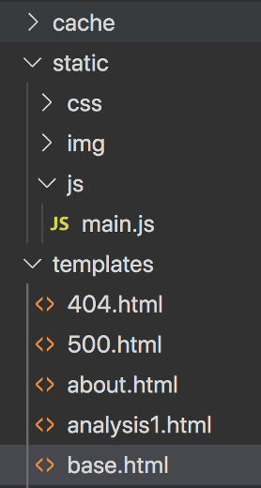




Slide 24







Slide 25


Slide 26
limitations
1 Data limitations
some vital information missing
a limited number of inhibitors in our database
2 Database limitations
database schema
SQLite ---->MySQL
3 Website usability limitations
limitation in searching

Slide 27
Future developments
● Interactivity
● Updatability of the database by shifting to another RDMS
● Backend database design and data available
● User input to adjust statistical analysis to their specific needs.
● Adjust the statistical analysis to be able to handle multiple inhibitors in a single file

